Slide 1
Welcome
Stand Quietly
Math Folder out

Slide 2
Lesson 10.6B Samples and Populations
CC.SS.7.SP.1 and CC.SS.7.SP.2
MP3 Construct Viable Arguments and Critique the Reasoning of Others
Notes:
0

Slide 3
Warm-Up
In a bag there are 2 red marbles, 3 white marbles and 5 blue marbles. Once a marble is selected, it is NOT replaced.
Is this an independent or dependent event? How do you know?
P(red, white)
P(blue, blue, white)

Slide 4


Population: the entire group of items or individuals being studied
Sample: a part of the population being studied
  A representative sample of the population is needed in order to make a valid inference, or an accurate prediction based on data.
Example
Sample: one penny from
each 7th grade student
Population: all pennies
currently in circulation

Slide 5
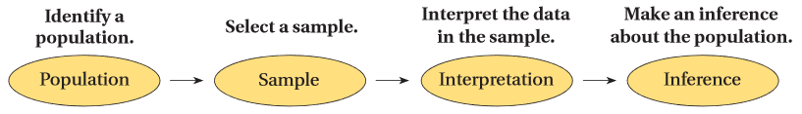

Slide 6
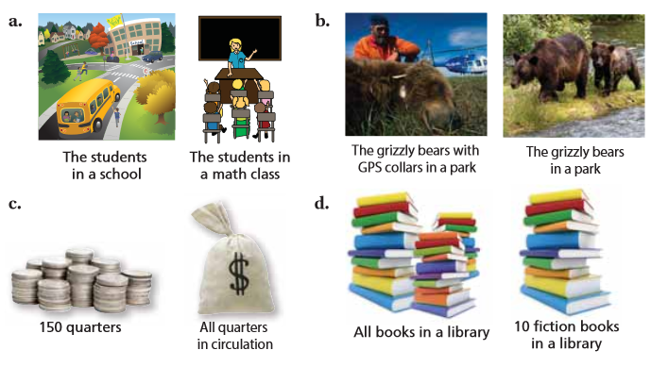
Which one is sample and population?

Slide 7
Unbiased sample: A sample that is selected so that it is representative of the entire population.
  An unbiased sample is selected at random and is large enough to provide accurate data.
Biased sample: A sample drawn in such a way that one or more parts of the population are favored over others.

Slide 8
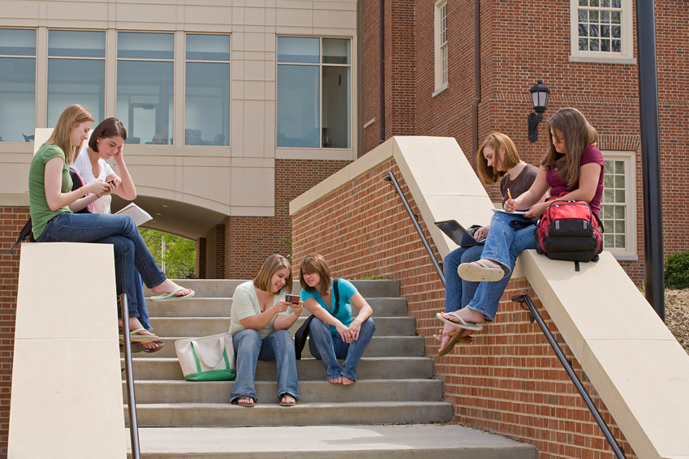
Example 1: A 7th grade advisory was surveyed to determine how many texts students at Marston Middle School send each day.
What is the population?
  All students in the school
What is the sample?
  Students in the seventh grade homeroom that was surveyed
Biased or unbiased?
  Biased. One class of 7th graders does not accurately represent all students in the school.

Slide 9
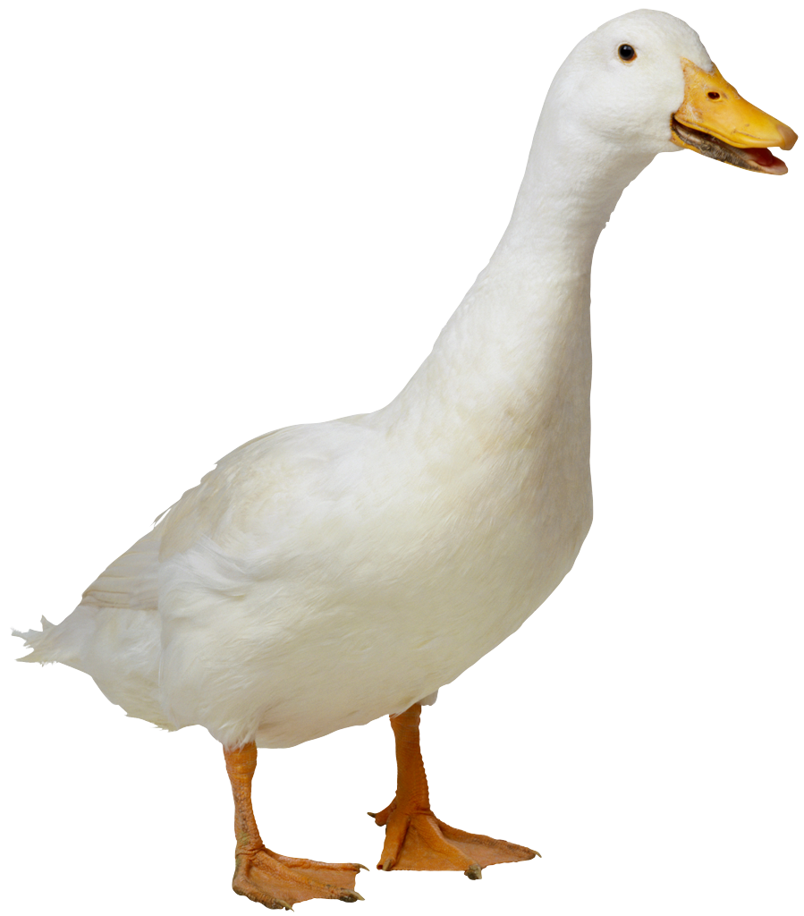
Example 2: To track migration patterns of a particular species of bird, scientists randomly tag, release, and track 50 birds of that species.
  What is the population?
    The species of bird being studied
  What is the sample?
    The 50 birds that the scientists tagged
    Tagged birds are specially marked birds that are tracked. Scientists use the data on these birds to
    make generalizations about an entire bird species.
  Biased or unbiased?
    Unbiased. The birds tagged were randomly
    selected.

Slide 10

Example 3: If you were taking a survey
of the different colors of leaves seen in September, which of the following would be an unbiased sample?
  100 fallen leaves collected from the ground
  100 leaves on tree branches
  50 fallen leaves and 50 leaves on branches
  50 fallen oak leaves, 50 oak leaves on branches
Biased: The same color of leaves might fall first.
Biased: The same color of leaves will come off the tree.
Unbiased: This gives a mix of leaves that have and have not fallen, and it doesn’t specify a certain type of tree.
Biased: This only looks at oak leaves, which may not represent all trees in the area.

Slide 11
Example 4: You want to estimate the number of 7th grade students that walk home right after school in the spring time. Which sample is unbiased?
  Three 7th grade students randomly selected in the hallway before homeroom
    Biased: The sample is too small to make an accurate conclusion.
  7th grade members of the Modified Track Team
    Biased: they stay after school for practice in the spring
  Every fifth 7th grader walking down the sidewalk after school
    Biased: they are already walking home when surveyed
  Every fifth student from an alphabetical list of the 7th graders
    Unbiased: represents the population of 7th graders, selected randomly, and large enough sample to provide accurate data

Slide 12
Random Sample
In a random sample, every member of the population has an equal chance of being chosen. There won’t be a biased view.
When a sample is selected at random, each member of the population is equally likely be selected.

Slide 13
Representative Sample
The representative sample posses the characteristics of the members of the population. A representative sample of the students in your school, for example, would include students from all grades.

Slide 14
Inference
An inference is an estimate or prediction about the population that is based on a sample.

Slide 15
Predicting Proportion:
sample piece
x (prediction)
sample size
entire population

Slide 16
Example 1: A university has 30,600 students. In a random sample of 240 students, 20 speak 3 or more languages. Predict the number of students at the university that speak 3 or more languages.
x = 2550 students

Slide 17
Example 2: There are 4500 elk located on a preserve in Colorado. A biologist thinks that the herd may be infected with parasite. She does a random sample of 50 elk. If she discovers that 8 of the sample is infected. Predict how many elk the biologist can expect to be infected.
720 elk are infected

Slide 18
Example 3: A factory produces 150,000 light bulbs per day. The manager estimates that less than 1,000 defective bulbs are produced each day. In a random sample of 250 light bulbs, there are 2 defective bulbs. Determine if the manager's estimate is likely to be accurate. Explain.
His estimate is incorrect. There are at least 1200 defective bulbs each day.

Slide 19
Example 4: A middle school has 2,500 students. Morgan interviewed 75 students about their library habits. She found that 45 of the students checked out a book weekly. Predict the number of students likely to check out books weekly.
1500 students

Slide 20
Example 5: Zack chooses a random sample of 50 out of 400 students. He finds that 7 of them have traveled to a foreign country. Zack claims that more than 50 of the 400 students have traveled to a foreign country. Do you agree with his answer? Explain.
Yes. 56 students have traveled.

