Slide 1
Lesson 15.1 Outcomes and Events
MP3 Construct Viable Arguments and Critique the Reasoning of Others

Slide 2

Vocabulary
Experiment: an investigation or a procedure that has varying results.
  Example: 6 marbles in a bag
Possible Outcomes: possible results of an experiment- good or bad, desired or not desired
  Example: I can get a blue, a purple, a yellow, a red, a green, or a green
Event: a collection of one or more outcomes
Favorable Outcomes: outcome of a specific event that you want
  Example: favorable outcomes for green is 2

Slide 3

Spinner Problem
How many possible outcomes are there?
  6 sections
In how many ways can spinning red occur?
  3 red sections
In how many ways can spinning not purple occur?
  5 sections that are not purple
What are the favorable outcome of spinning not purple?
  Red, red, red, green, and blue

Slide 4
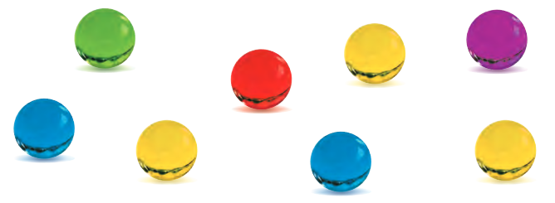
Marble Problem
You randomly choose a marble.
How many possible outcomes are there?
  8 possible outcomes
In how many ways can choosing blue occur?
  2 ways to choose blue
In how many ways can choosing not yellow occur?
  5 ways to choose not yellow
What are the favorable outcomes of choosing not yellow?
  Blue, blue, green, red, purple

Slide 5
Lesson 15. 2 Probability
Students will be able to understand the concept of probability and the relationship between probability and likelihood. Students will be able to find the probabilities of events.
CCSS.7.SP.5 and CCSS.7.SP.7a
MP6 Attend to Precision

Slide 6
Probability
Probability is a measure of how likely an event is to occur.

Slide 7
Probability
Probabilities are written as:
  Fractions from 0 to 1
  Decimals from 0 to 1
  Percents from 0% to 100%

Slide 8
Probability
If an event is CERTAIN to happen, then the probability of the event is 1 or 100%.
If an event will NEVER to happen, then the probability of the event is 0 or 0%.
If an event is just as EQUALLY LIKELY to happen as to not happen, then the probability of the event is ½, 0.5 or 50%.

Slide 9
Probability
Impossible Unlikely Equal Chances Likely Certain
0 0.5 1
0% 50% 100%
½

Slide 10

Probability
When a meteorologist states that the chance of rain is 50%, the meteorologist is saying that it is equally likely to rain or not to rain.
If the chance of rain rises to 80%, it is more likely to rain.
If the chance drops to 20%, then it may rain, but it probably will not rain.

Slide 11
Probability
List 2 events that will never happen and have a probability of 0%.
List 2 events that are certain to happen and have a probability of 100%.
List 2 events that have equal chances of happening and have a probability of 50%.

Slide 12
Probability
The probability of an event is written:
P(event) = number of ways event can occur
total number of outcomes

Slide 13
Probability
An outcome is a possible result of a probability experiment
    Example: When rolling a number cube, the possible outcomes are 1, 2, 3, 4, 5, and 6

Slide 14
Probability
An event is a specific result of a probability experiment
    Example: When rolling a number cube, the event of rolling an even number is 3 (you could roll a 2, 4 or 6).

Slide 15
Example 1
P(event) = number of ways event can occur
total number of outcomes
What is the probability of getting heads when flipping a coin?
P(heads) = number of ways = 1 head on a coin = 1
total outcomes = 2 sides to a coin = 2
P(heads)= ½ = 0.5 = 50%

Slide 16
Example 2
1. What is the probability that the spinner will stop on part A?
B
A
C
D
What is the probability that the spinner will stop on
    An even number?
    An odd number?
3
1
2
A
3. What is the probability that the spinner will stop in the area marked A?
C
B

Slide 17
Example 3
Lawrence is the captain of his track team. The team is deciding on a color and all eight members wrote their choice down on equal size cards. If Lawrence picks one card at random, what is the probability that he will pick blue?
Number of blues = 3
Total cards = 8
3/8 or 0.375 or 37.5%
blue
blue
green
black
yellow
blue
red
black

Slide 18
Example 4
Donald is rolling a number cube labeled 1 to 6. What is the probability of the following?
a.) an odd number
      odd numbers – 1, 3, 5
      total numbers – 1, 2, 3, 4, 5, 6
      b.) a number greater than 5
      numbers greater – 6
      total numbers – 1, 2, 3, 4, 5, 6
3/6 = ½ = 0.5 = 50%
1/6 = 0.166 = 16.6%

Slide 19
Example 5
1. What is the probability of spinning a number greater than 1?
1
2
3
4
What is the probability that a spinner with five congruent sections numbered 1-5 will stop on an even number?
3. What is the probability of rolling a multiple of 2 with one toss of a number cube?

Slide 20
Lesson 15.3
Experimental Probability Vs. Theoretical Probability
Students will be able to explore experimental and theoretical probability with experiments. Students will be able to calculate and compare both probabilities.
(MP6 Attend to Precision. CCSS.7.SP.5, CCSS.7.SP.6, and CCSS.7.SP.7)

Slide 21
What do you know about probability?
Probability is a number from 0 to 1 that tells you how likely something is to happen.
Probability can have two approaches -experimental probability
-theoretical probability

Slide 22
Contrast experimental and theoretical probability
Experimental probability is the result (outcome) of doing the experiment.
Theoretical probability is what is expected to happen (in theory).

Slide 23
Example 1
Experimental:
You tossed a coin 10 times and recorded a head 3 times, a tail 7 times
P(head)= 3/10
P(tail) = 7/10
Theoretical:
Toss a coin and getting a head or a tail is 1/2.
P(head) = 1/2
P(tail) = 1/2

Slide 24
Experimental vs.Theoretical
Theoretical probability:
P(E) = number of favorable outcomes total number of possible outcomes
Experimental probability:
P(event) = number of times event occurs
total number of trials

Slide 25
Lesson 15.5 Independent and Dependent Events
(CC.SS.7.SP.8a and CC.SS.7.SP.8b. MP3 Construct Viable Arguments)
Slide 25

Slide 26
Independent Events
Whatever happens in one event has absolutely nothing to do with what will happen next because:
    The two events are unrelated
    OR
    You repeat the experiment with an item whose numbers will not change (ex. spinners or dice)
    OR
    You repeat the same activity, but you REPLACE (put it back) the item that was removed.
Slide 26

Slide 27
Dependent Event
The result of the second event (pick) will change because of what happened on the first event (pick).
Slide 27

Slide 28
TEST YOURSELF
Are these dependent or independent events?
Tossing two dice and getting a 6 on both of them.
2. You have a bag of marbles: 3 blue, 5 white, and 12 red. You choose one marble out of the bag, look at it then put it back. Then you choose another marble.
3. You have a basket of socks. You need to find the probability of pulling out a black sock and its matching black sock without putting the first sock back.
4. You pick the letter Q from a bag containing all the letters of the alphabet. You do not put the Q back in the bag before you pick another tile.
Independent
Independent
dependent
dependent
Slide 28

Slide 29
Rewrite each question as a probability notation
1. What is the probability of tossing two dice and getting a 6 on both of them?
You can write P(6 and 6) or P(6, 6)
2. You have a bag of marbles: 3 blue, 5 white, and 12 red. You choose one marble out the bag, look at it then put it back. Then you choose another marble. What is the probability of picking a red and white?
You can write P(red and white) or P(red, white)
3. You have a basket of socks. You need to find the probability of pulling out a black sock and its matching black sock without putting the first sock back.
You can write P(black and black) or P(black, black)
4. You pick the letter Q from a bag containing all the letters of the alphabet. You do not put the Q back in the bag before you pick another tile. What is the probability of getting a Q first and a T second?
You can write P(Q and T) or P(Q,T)

Slide 30
Watch the video and take notes
https://www.youtube.com/watch?v=gNRT2KoyT7U
Extra video: https://www.youtube.com/watch?v=eKQVMYT1exE

Slide 31
Lesson 15.6A Samples and Populations
CC.SS.7.SP.1 and CC.SS.7.SP.2
MP3 Construct Viable Arguments and Critique the Reasoning of Others
Notes:
0

Slide 32


Population: the entire group of items or individuals being studied
Sample: a part of the population being studied
  A representative sample of the population is needed in order to make a valid inference, or an accurate prediction based on data.
Example
Sample: one penny from
each 7th grade student
Population: all pennies
currently in circulation

Slide 33
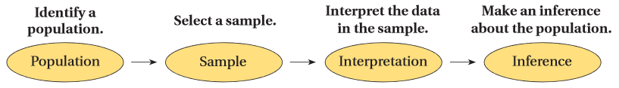

Slide 34
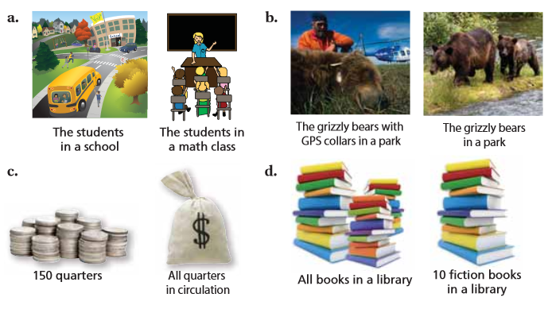
Which one is sample and population?

Slide 35
Unbiased sample: A sample that is selected so that it is representative of the entire population.
  An unbiased sample is selected at random and is large enough to provide accurate data.
Biased sample: A sample drawn in such a way that one or more parts of the population are favored over others.

Slide 36
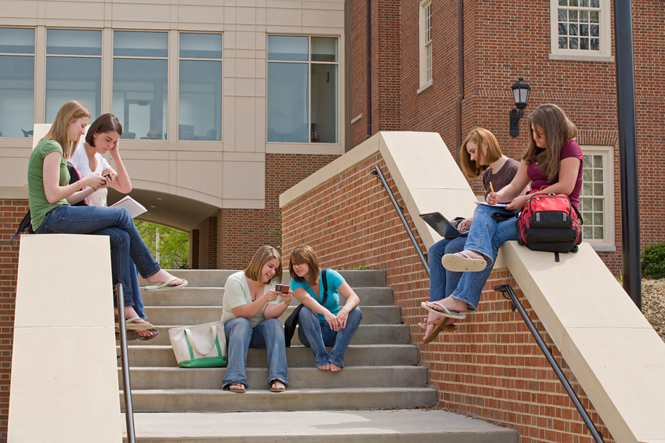
Example 1: A 7th grade advisory was surveyed to determine how many texts students at Marston Middle School send each day.
What is the population?
  All students in the school
What is the sample?
  Students in the seventh grade advisory that was surveyed
Biased or unbiased?
  Biased. One class of 7th graders does not accurately represent all students in the school.

Slide 37

Example 2: To track migration patterns of a particular species of bird, scientists randomly tag, release, and track 50 birds of that species.
  What is the population?
    The species of bird being studied
  What is the sample?
    The 50 birds that the scientists tagged
    Tagged birds are specially marked birds that are tracked. Scientists use the data on these birds to
    make generalizations about an entire bird species.
  Biased or unbiased?
    Unbiased. The birds tagged were randomly
    selected.

Slide 38

Example 3: If you were taking a survey
of the different colors of leaves seen in September, which of the following would be an unbiased sample?
  100 fallen leaves collected from the ground
  100 leaves on tree branches
  50 fallen leaves and 50 leaves on branches
  50 fallen oak leaves, 50 oak leaves on branches
Biased: The same color of leaves might fall first.
Biased: The same color of leaves will come off the tree.
Unbiased: This gives a mix of leaves that have and have not fallen, and it doesn’t specify a certain type of tree.
Biased: This only looks at oak leaves, which may not represent all trees in the area.

Slide 39
Example 4: You want to estimate the number of 7th grade students that walk home right after school in the spring time. Which sample is unbiased?
  Three 7th grade students randomly selected in the hallway before homeroom
    Biased: The sample is too small to make an accurate conclusion.
  7th grade members of the Modified Track Team
    Biased: they stay after school for practice in the spring
  Every fifth 7th grader walking down the sidewalk after school
    Biased: they are already walking home when surveyed
  Every fifth student from an alphabetical list of the 7th graders
    Unbiased: represents the population of 7th graders, selected randomly, and large enough sample to provide accurate data

Slide 40
Random Sample
In a random sample, every member of the population has an equal chance of being chosen. There won’t be a biased view.
When a sample is selected at random, each member of the population is equally likely to be selected.

Slide 41
Representative Sample
The representative sample posses the characteristics of the members of the population. A representative sample of the students in your school, for example, would include students from all grades.

Slide 42
Inference
An inference is an estimate or prediction about the population that is based on a sample.

Slide 43
Predicting Proportion:
sample piece
x (prediction)
sample size
entire population

Slide 44
Example 1: A university has 30,600 students. In a random sample of 240 students, 20 speak 3 or more languages. Predict the number of students at the university that speak 3 or more languages.
x = 2550 students

Slide 45
Example 2: There are 4500 elk located on a preserve in Colorado. A biologist thinks that the herd may be infected with parasite. She does a random sample of 50 elk. If she discovers that 8 of the sample is infected. Predict how many elk the biologist can expect to be infected.
720 elk are infected

Slide 46
Example 3: A factory produces 150,000 light bulbs per day. The manager estimates that less than 1,000 defective bulbs are produced each day. In a random sample of 250 light bulbs, there are 2 defective bulbs. Determine if the manager's estimate is likely to be accurate. Explain.
His estimate is incorrect. There are at least 1200 defective bulbs each day.

Slide 47
Example 4: A middle school has 2,500 students. Morgan interviewed 75 students about their library habits. She found that 45 of the students checked out a book weekly. Predict the number of students likely to check out books weekly.
1500 students

Slide 48
Example 5: Zack chooses a random sample of 50 out of 400 students. He finds that 7 of them have traveled to a foreign country. Zack claims that more than 50 of the 400 students have traveled to a foreign country. Do you agree with his answer? Explain.
Yes. 56 students have traveled.

