Slide 1
Lesson 7.4 Real Numbers

Slide 2
Terminating Decimals
A terminating decimal is a decimal that ends.
Examples: 1.3, -13. 24, 0.134

Slide 3
Repeating Decimal
A repeating decimal is a decimal that repeats.
Example: -1.3333… = $−1.\overline{3}$
Example: 0.51515… = $0.\overline{51}$
Example: -12.135135… = $−12.\overline{135}$

Slide 4
REAL NUMBERS
RATIONAL NUMBERS
IRRATIONAL NUMBERS

Slide 5
Rational Numbers
can be written as a ratio (fraction) of two integers. (proper fractions, improper fractions, or mixed numbers)
Can be written in decimal form: terminating decimal or repeating decimal.
Can be written as an integer
Can be written as a percent
square roots of perfect squares (doubles)

Slide 6
Irrational
is a real number that cannot be written as a simple fraction. Irrational means not Rational

Slide 7
Integers
Whole numbers that are negative, positive, and zero. Integers can also be written as a fraction.
Example: $3=\frac{3}{1}$ (putting a 1 in the denominator does not change the original value)

Slide 8
Whole Numbers
Numbers that start with zero and go all the way to positive whole numbers.
Example: 0, 1, 2, 3, …

Slide 9
Natural Numbers
Only positive numbers that does not include zero
Example : 1, 2, 3, 4...

Slide 10
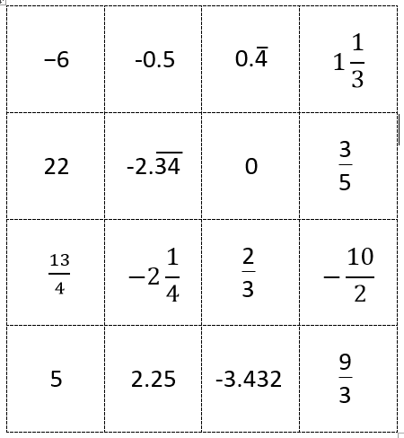
Math Word Sort
Determine each values if it is, real, irrational, rational, integers, whole, or natural

